Slide 1
Apparent Stereo: The Cornsweet Illusion Can Enhance Perceived Depth
ZHANG, Guangde

Slide 2

What is Cornsweet Illusion

Slide 3
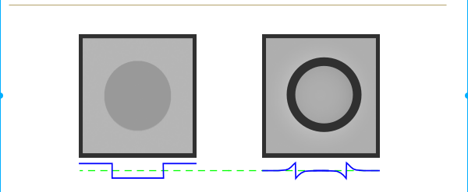
What is Cornsweet Illusion

Slide 4
What is Cornsweet Illusion

Slide 5
How big the width of the area?
10 pixel
20 pixel

Slide 6
How big the width of the area?
30 pixel
40 pixel

Slide 7
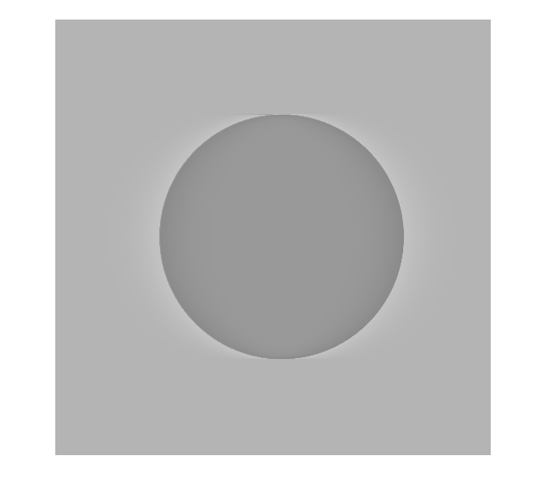

How big the width of the area?
60 pixel
80 pixel
100 pixel

Slide 8
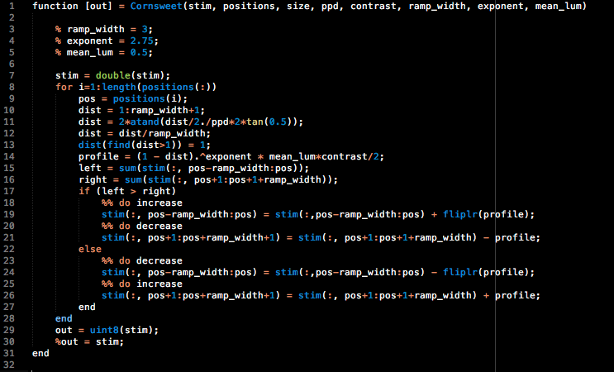
How to create Cornsweet Profile?

Slide 9
What is the Disparity?

